Slide 1
Sequence Diagram

Slide 2
What is a Sequence Diagram?
Sequence diagrams, commonly used by developers, model the interactions between objects in a single use case.
They illustrate how the different parts of a system interact with each other to carry out a function, and the order in which the interactions occur when a particular use case is executed.
In simpler words, a sequence diagram shows different parts of a system work in a ‘sequence’ to get something done.
It is also called an event diagram.

Slide 3

Sequence Diagram Notations
Class Roles or Participants
    Class roles describe the way an object will behave in context. Use the UML object symbol to illustrate class roles, but don't list object attributes.

Slide 4
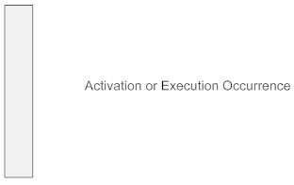
Activation or Execution Occurrence
    Activation boxes represent the time an object needs to complete a task. When an object is busy executing a process or waiting for a reply message, use a thin gray rectangle placed vertically on its lifeline.

Slide 5
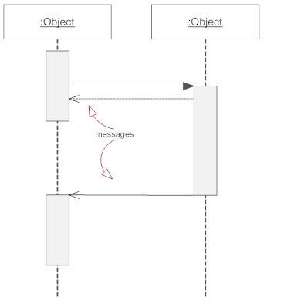
Messages
    Messages are arrows that represent communication between objects. Use half-arrowed lines to represent asynchronous messages. Asynchronous messages are sent from an object that will not wait for a response from the receiver before continuing its tasks.
        message_name (arguments): return_type

Slide 6
Types of Messages in Sequence Diagrams
Synchronous Message
A synchronous message requires a response before the interaction can continue. It's usually drawn using a line with a solid arrowhead pointing from one object to another.
Asynchronous Message
Asynchronous messages don't need a reply for interaction to continue. Like synchronous messages, they are drawn with an arrow connecting two lifelines; however, the arrowhead is usually open and there's no return message depicted.
Reply or Return Message
A reply message is drawn with a dotted line and an open arrowhead pointing back to the original lifeline.

Slide 7
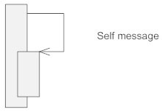
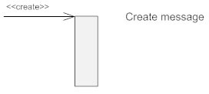
Self Message
    A message an object sends to itself, usually shown as a U shaped arrow pointing back to itself. It is also called reflexive message.
Create Message
    This is a message that creates a new object. Similar to a return message, it's depicted with a dashed line and an open arrowhead that points to the rectangle representing the object created.

Slide 8

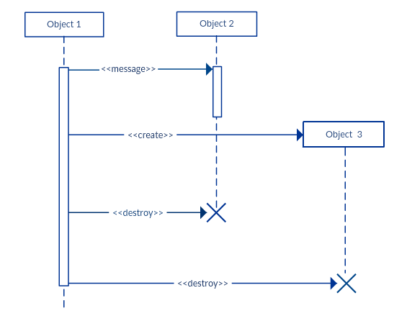
Delete Message
This is a message that destroys an object. It can be shown by an arrow with an x at the end.

Slide 9
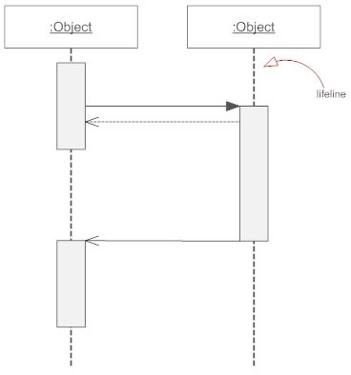
Lifelines
  Lifelines are vertical dashed lines that indicate the object's presence over time.

Slide 10
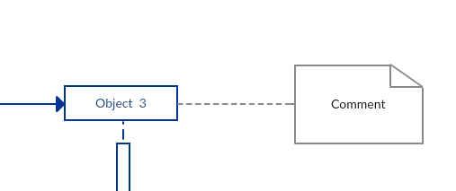
Destroying Objects
Objects can be terminated early using an arrow labeled "<< destroy >>" that points to an X. This object is removed from memory. When that object's lifeline ends, you can place an X at the end of its lifeline to denote a destruction occurrence.
Loops
A repetition or loop within a sequence diagram is depicted as a rectangle. Place the condition for exiting the loop at the left corner in square brackets [ ].
Comment
UML diagrams generally permit the annotation of comments in all UML diagram types. The comment object is a rectangle with a folded-over corner as shown below. The comment can be linked to the related object with a dashed line.

Slide 11
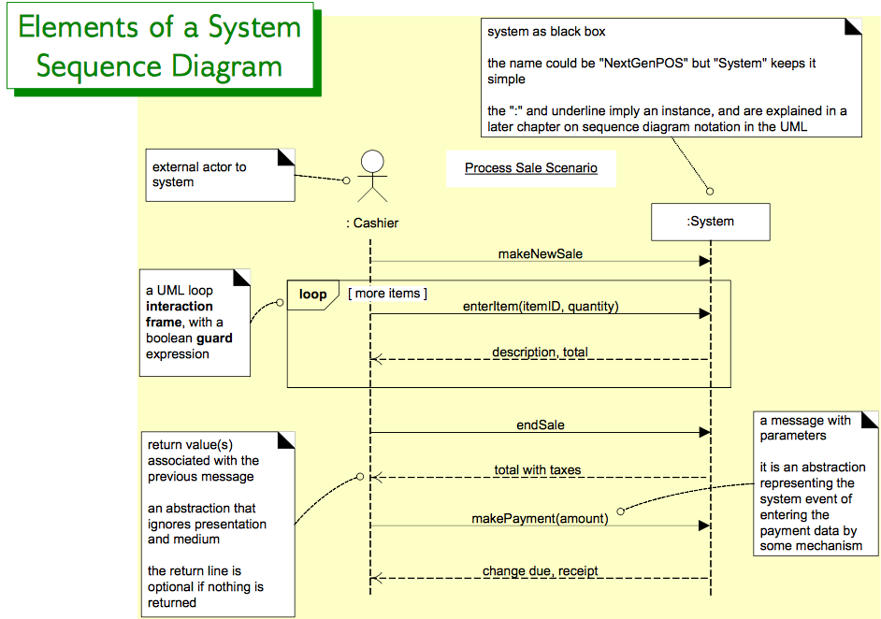

Slide 12
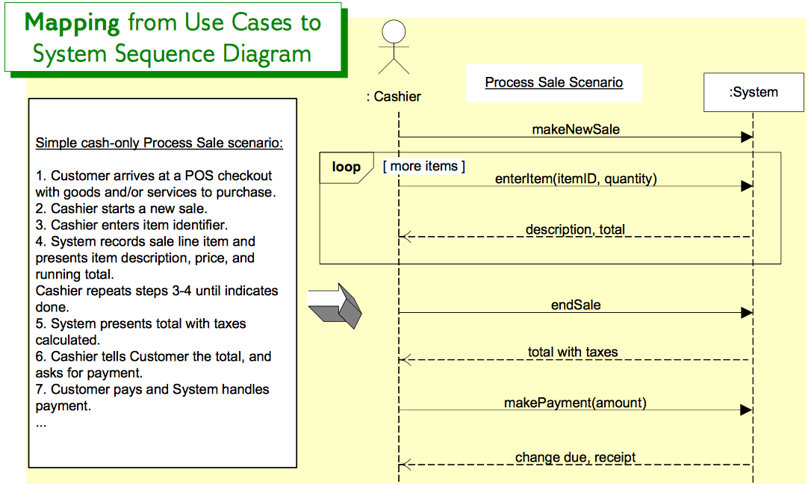

Slide 13
